Slide 1

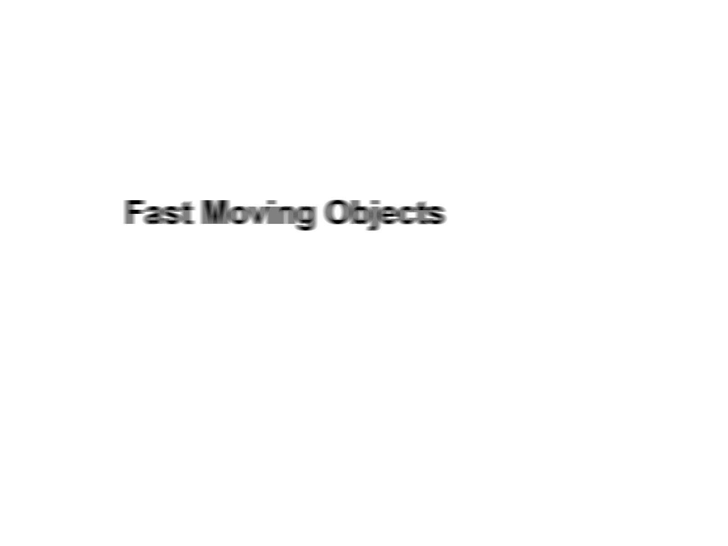


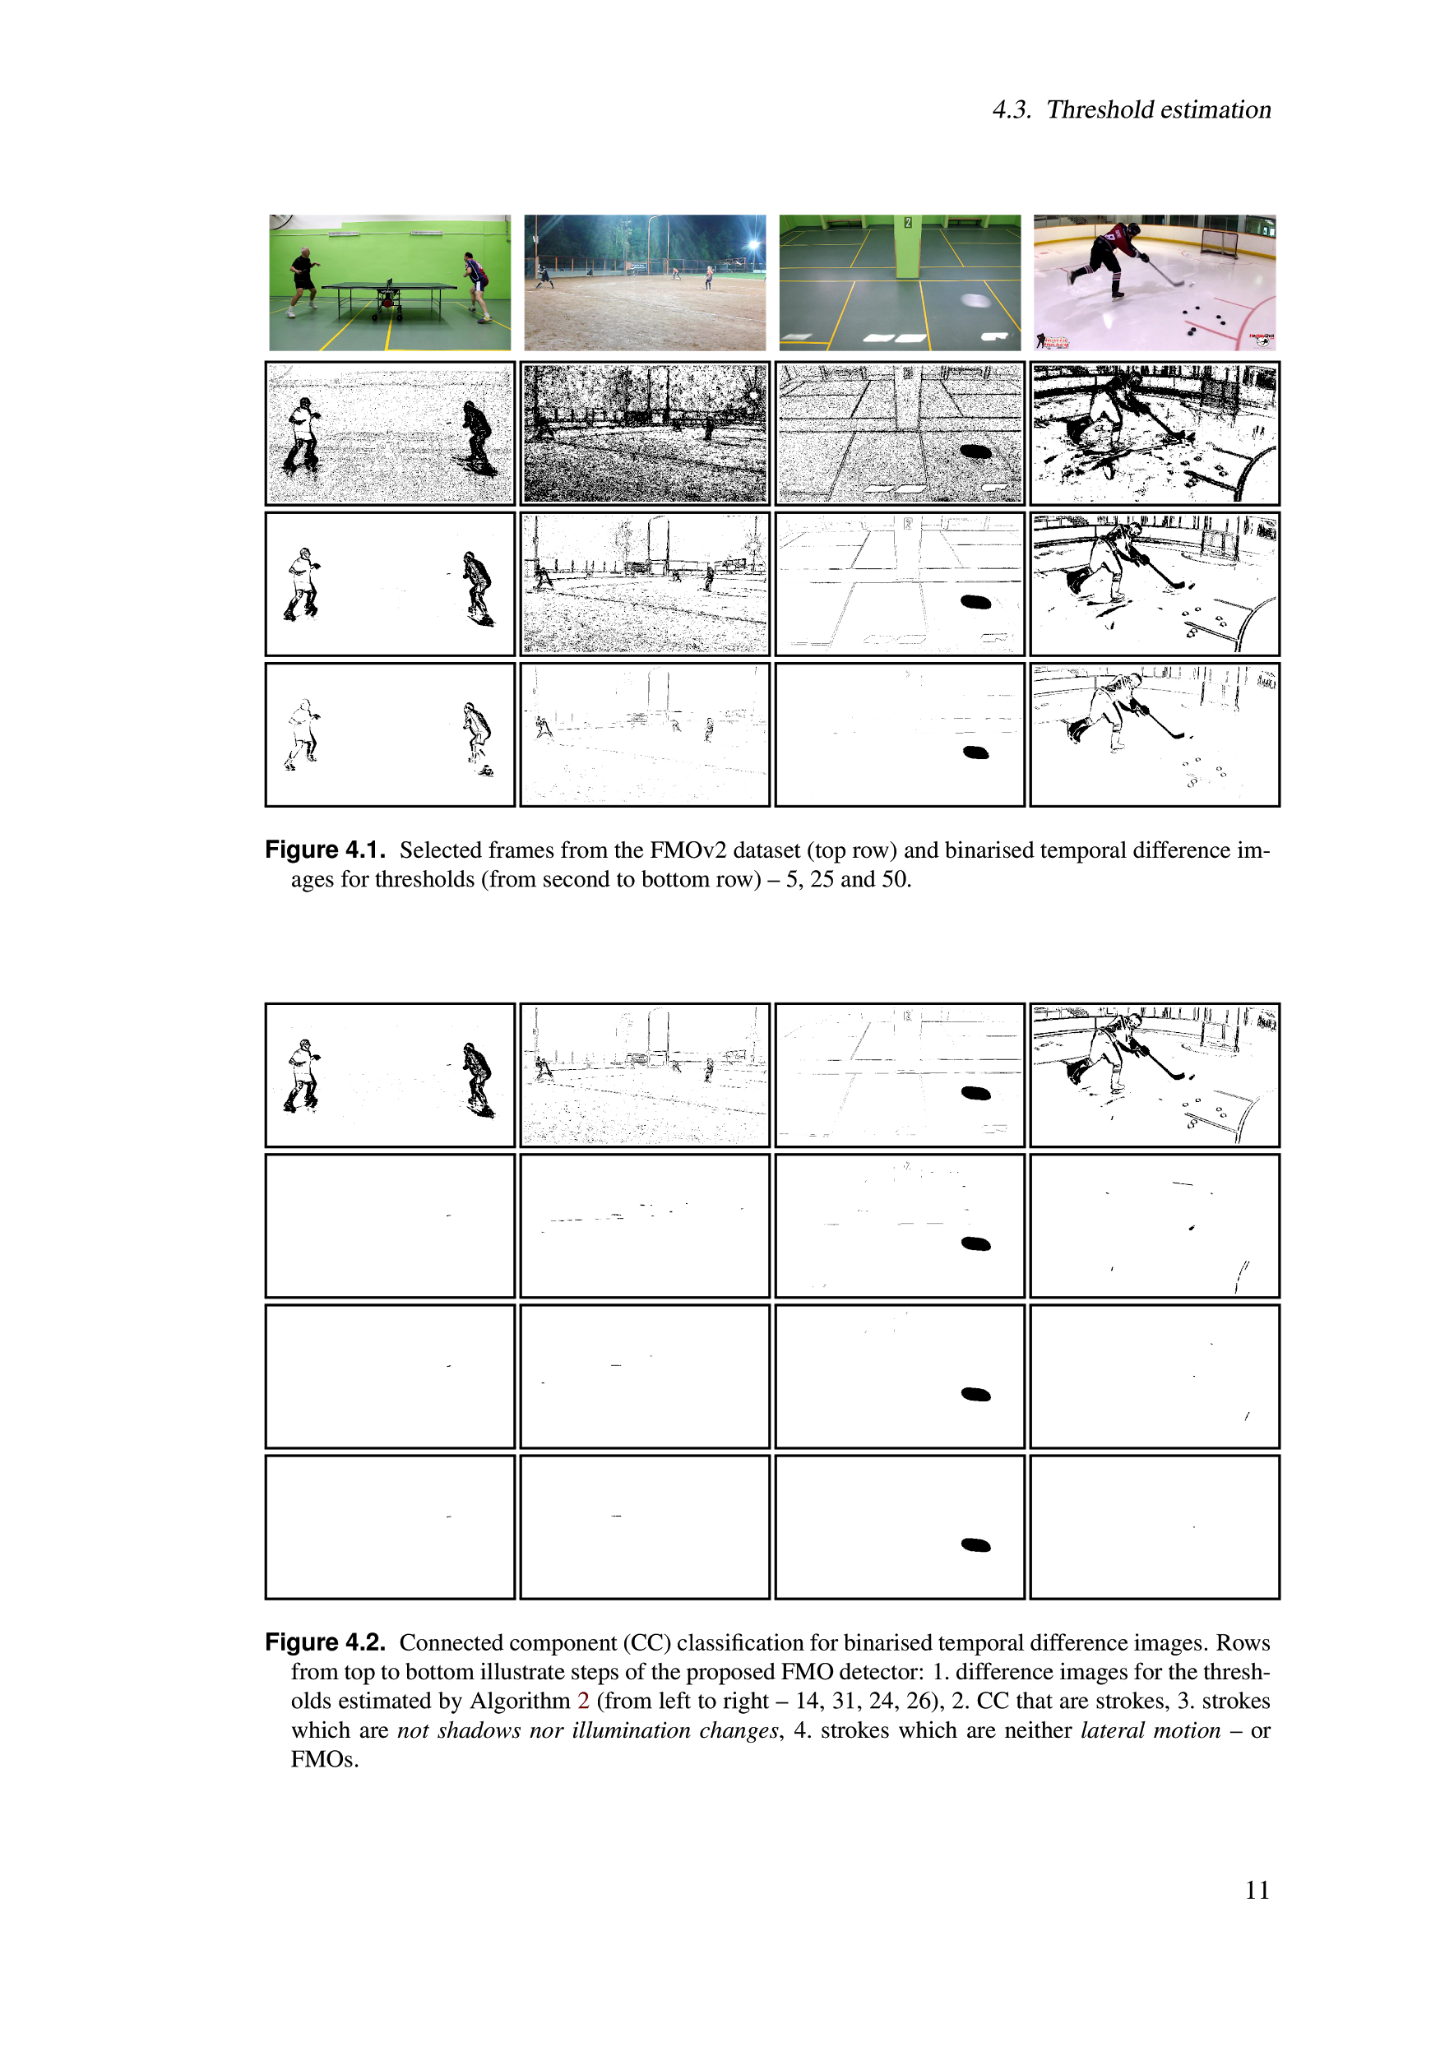
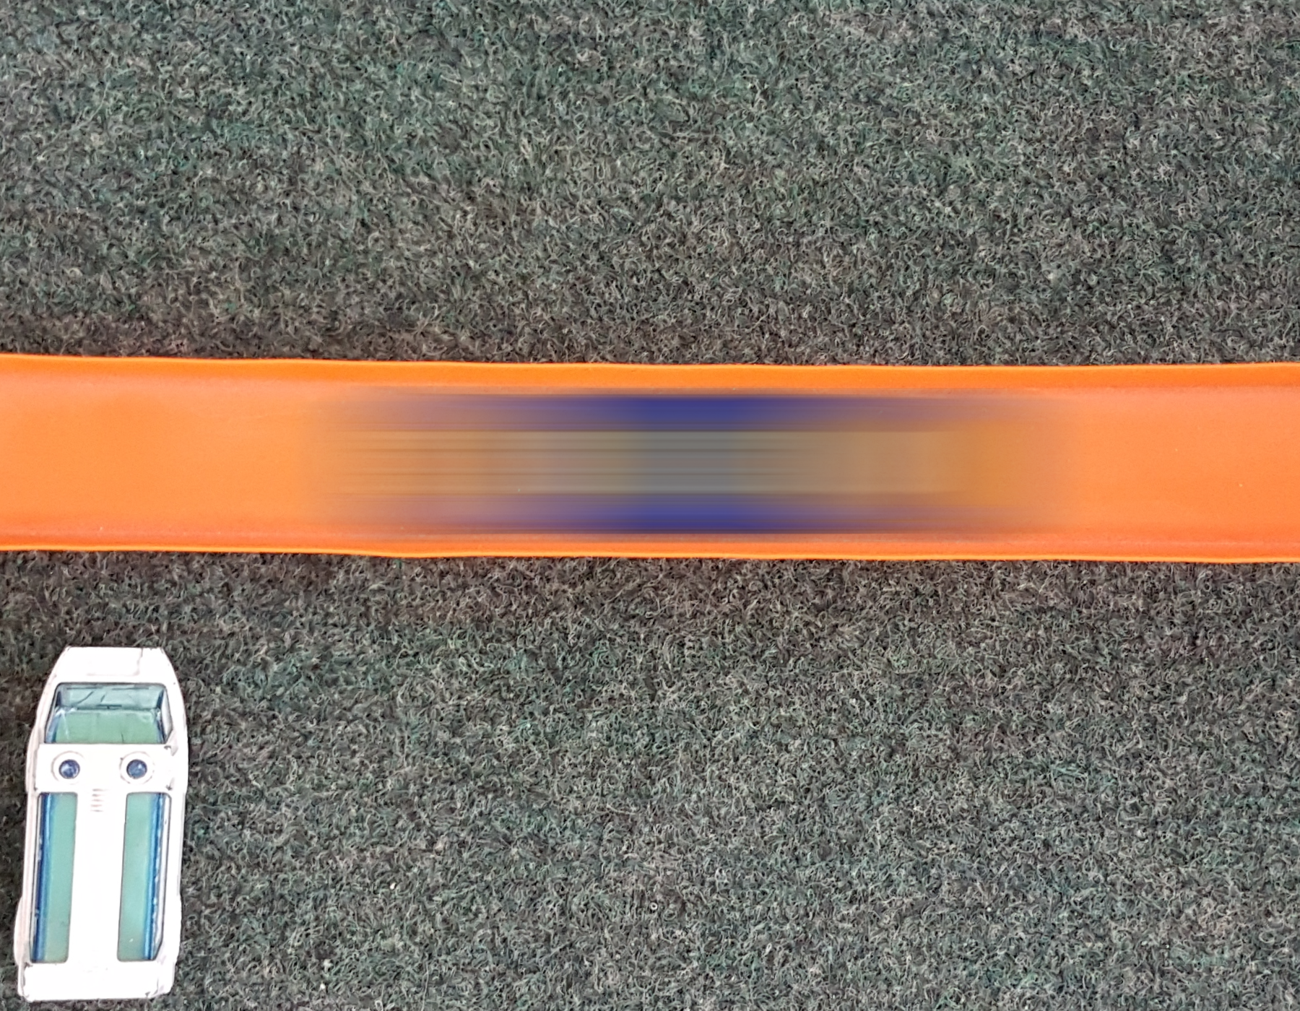

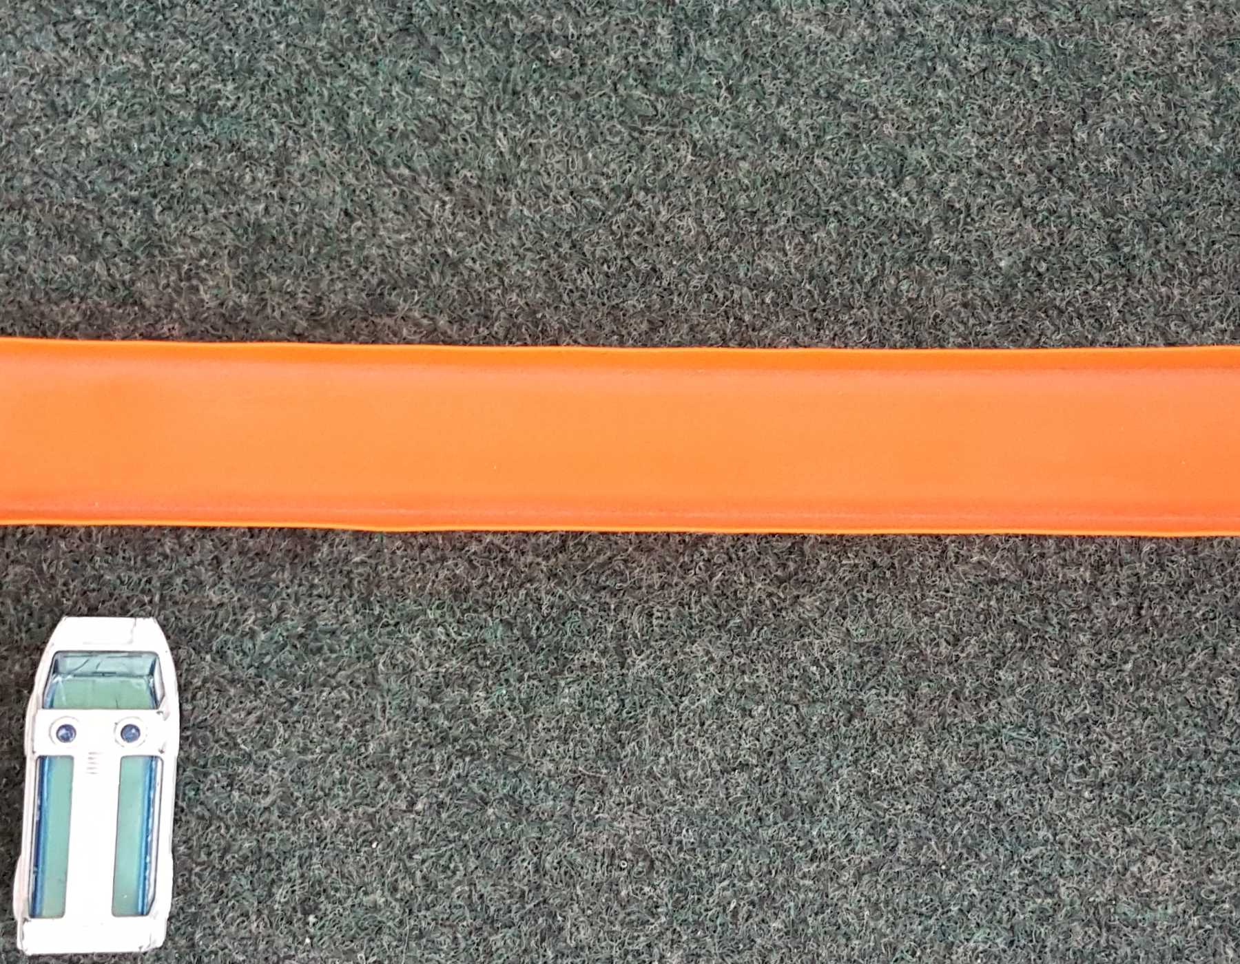
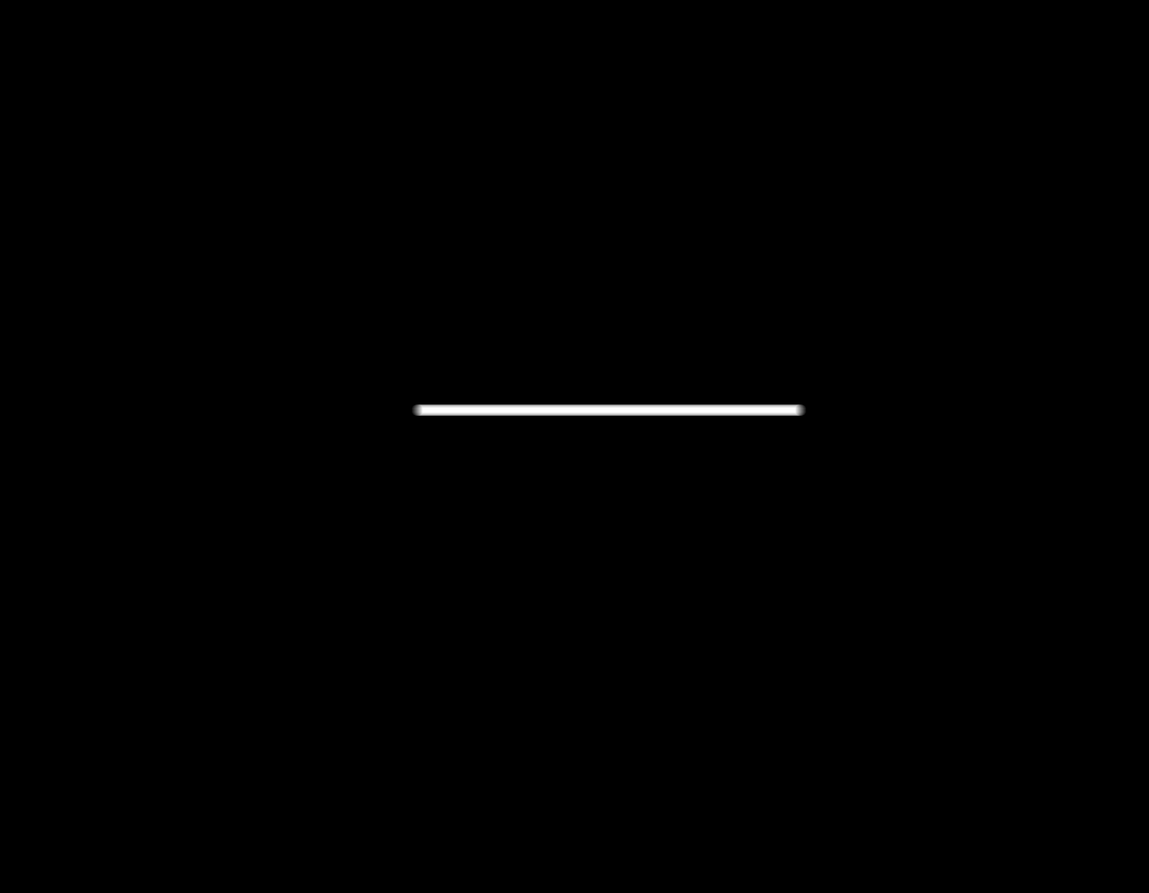
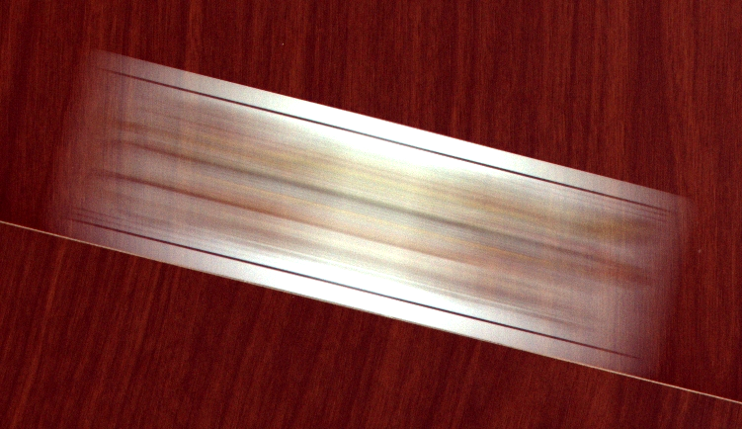
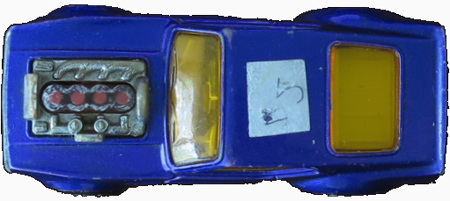
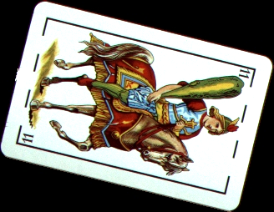
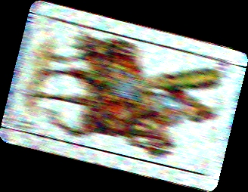
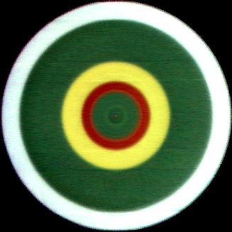
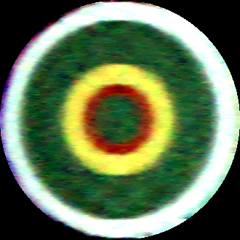
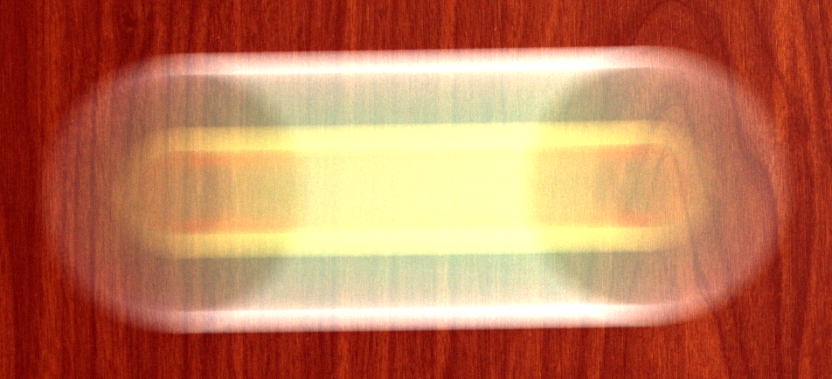
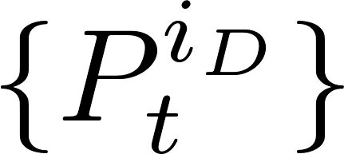
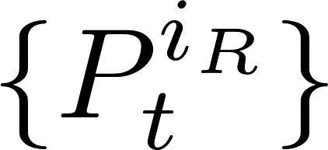
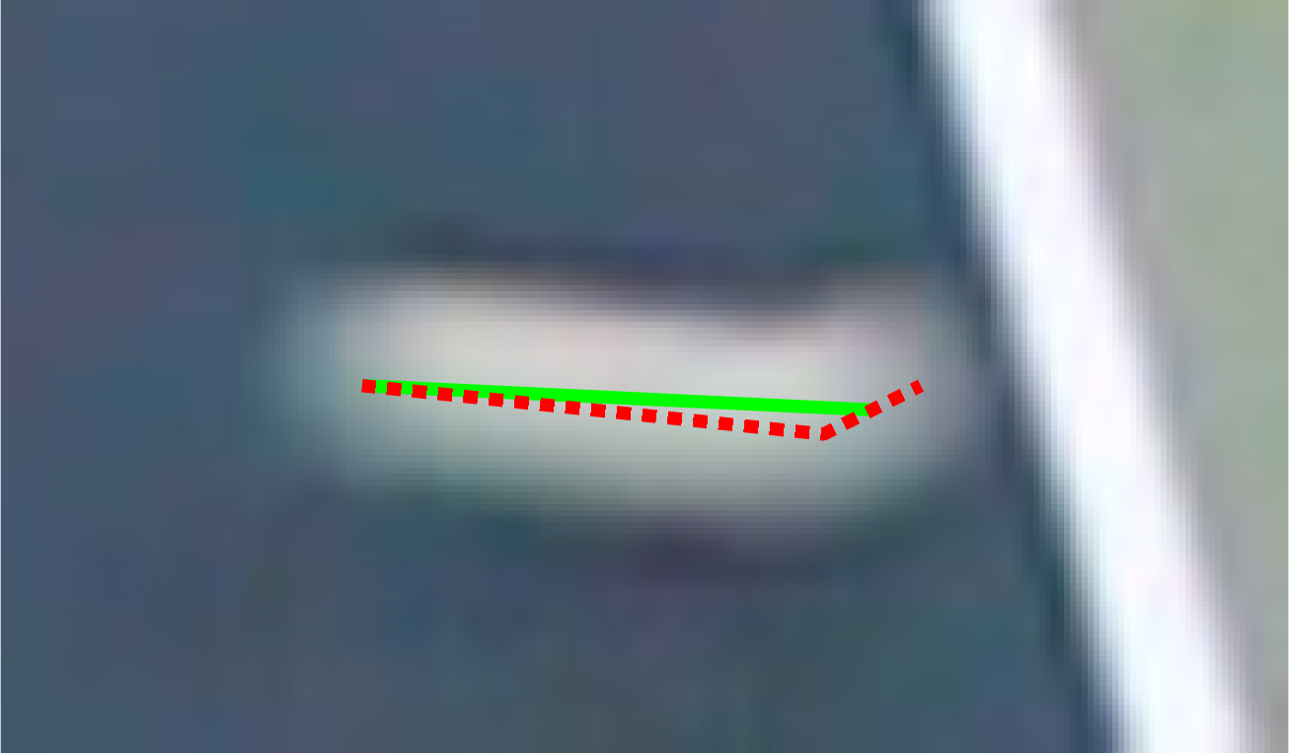
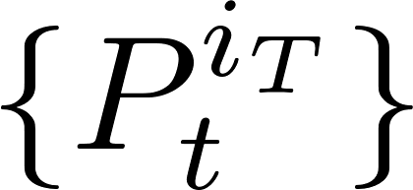
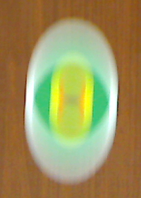
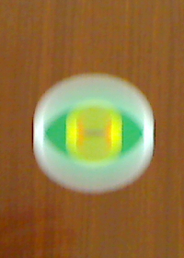
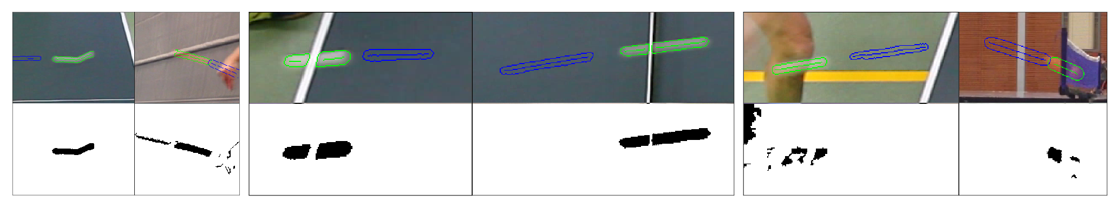

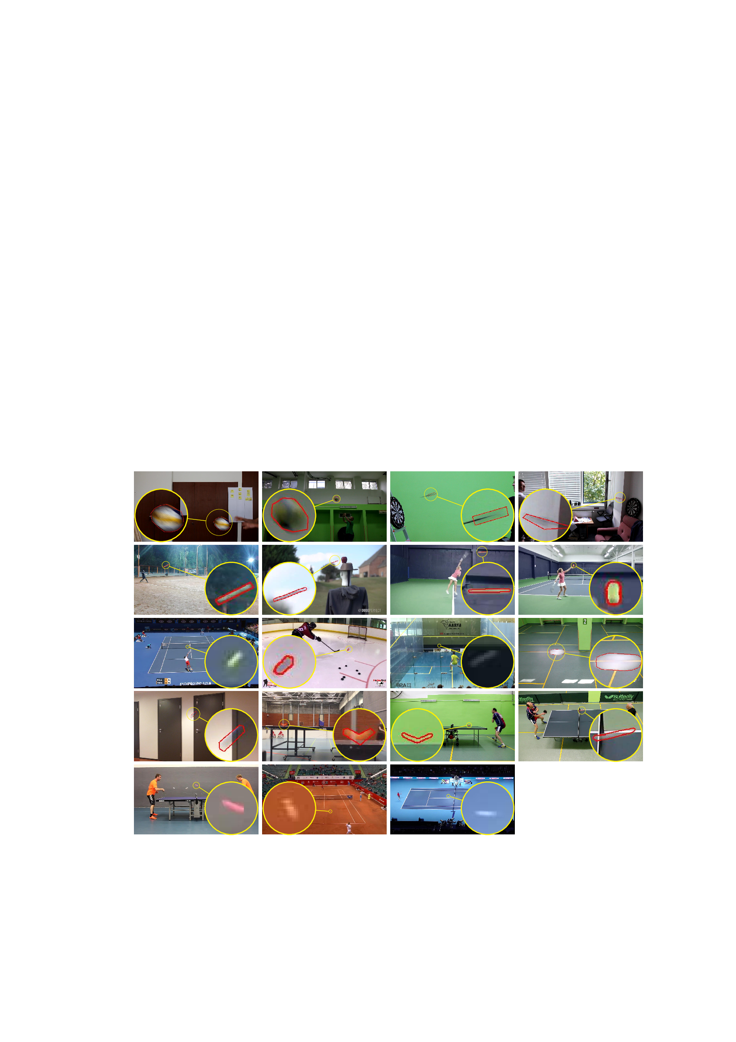
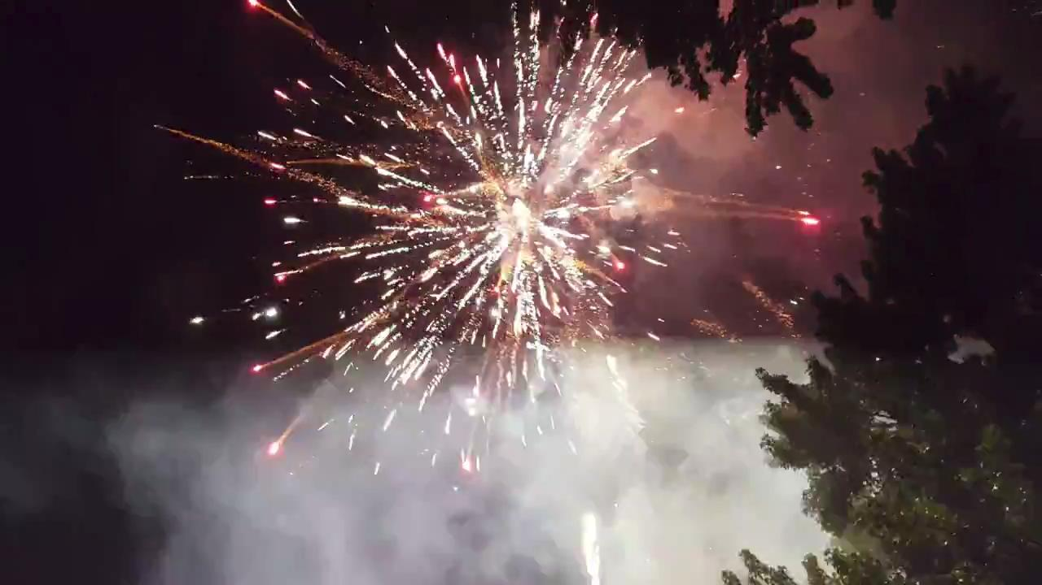
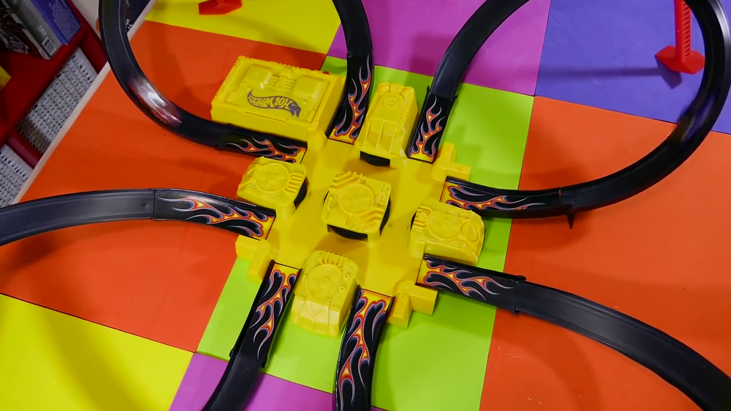
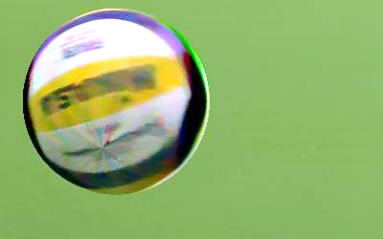

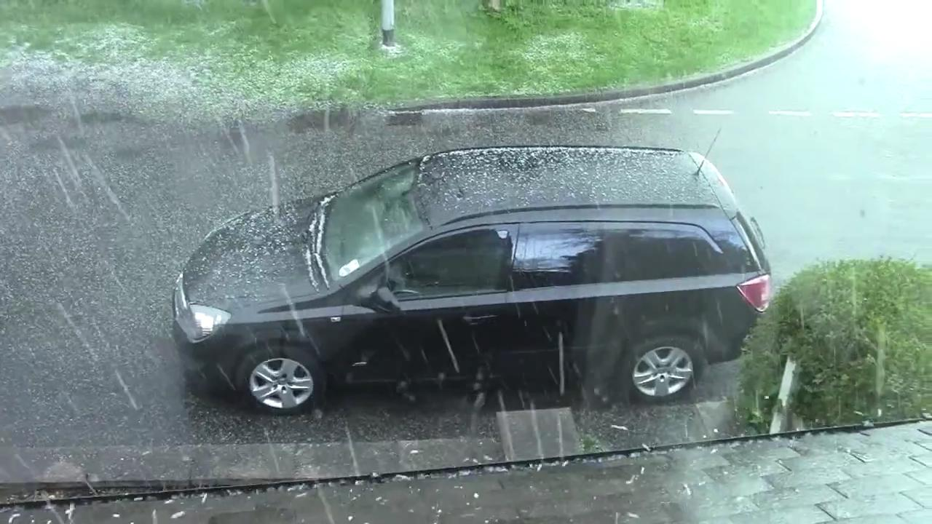
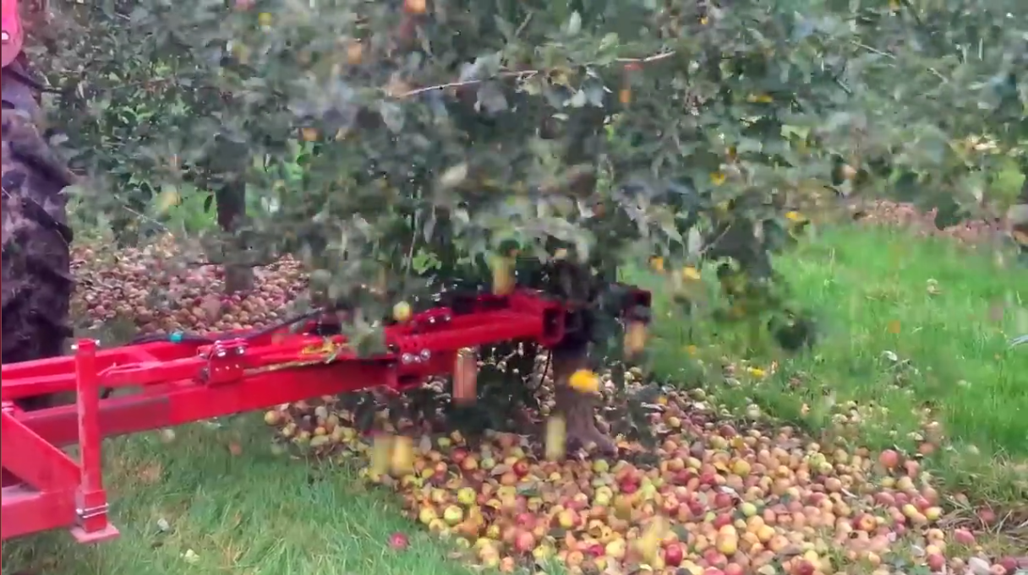
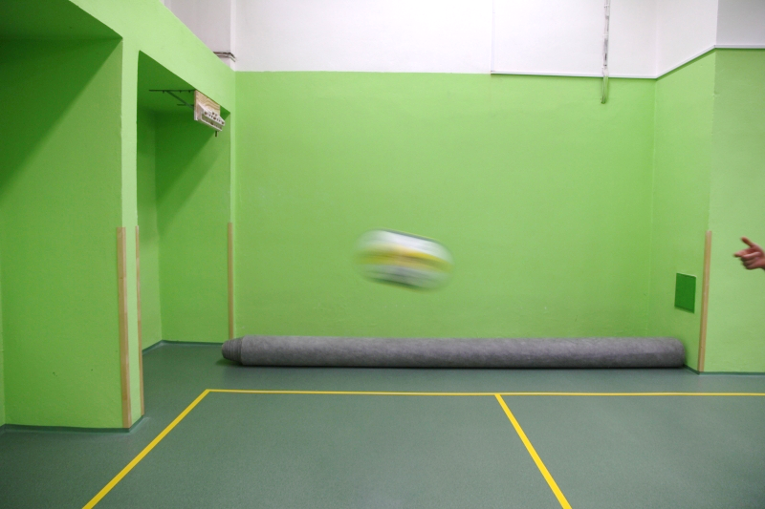
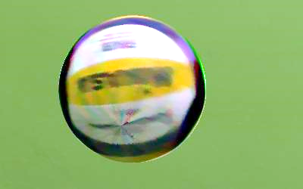


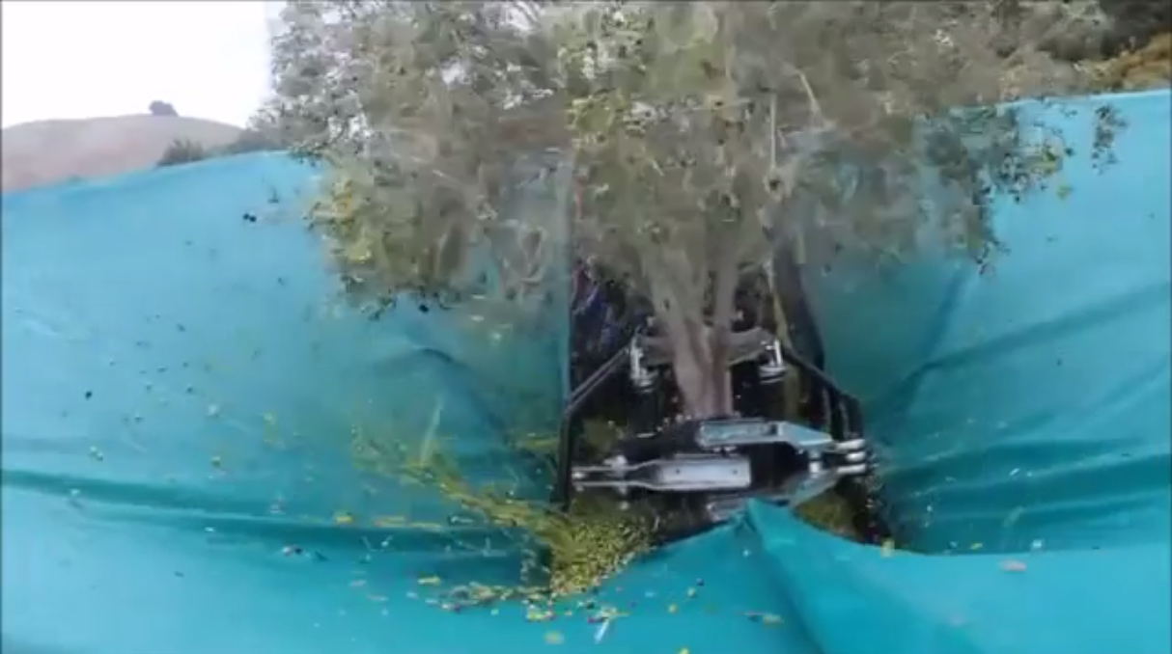
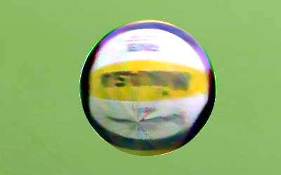

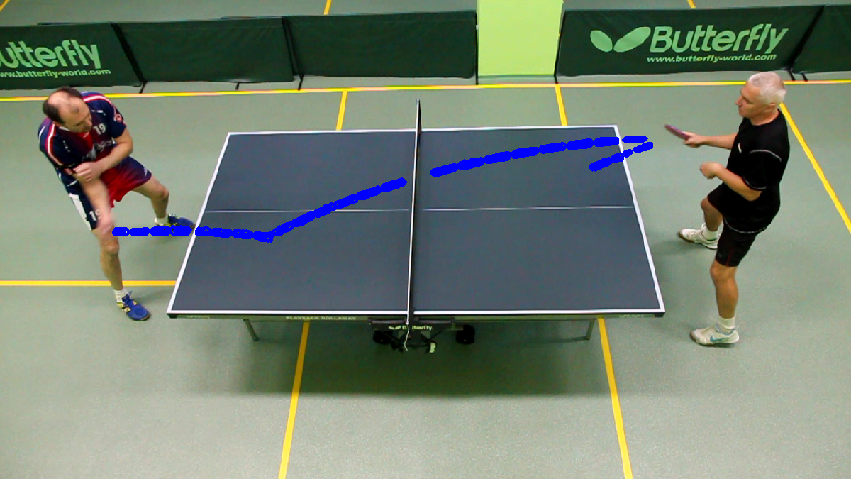
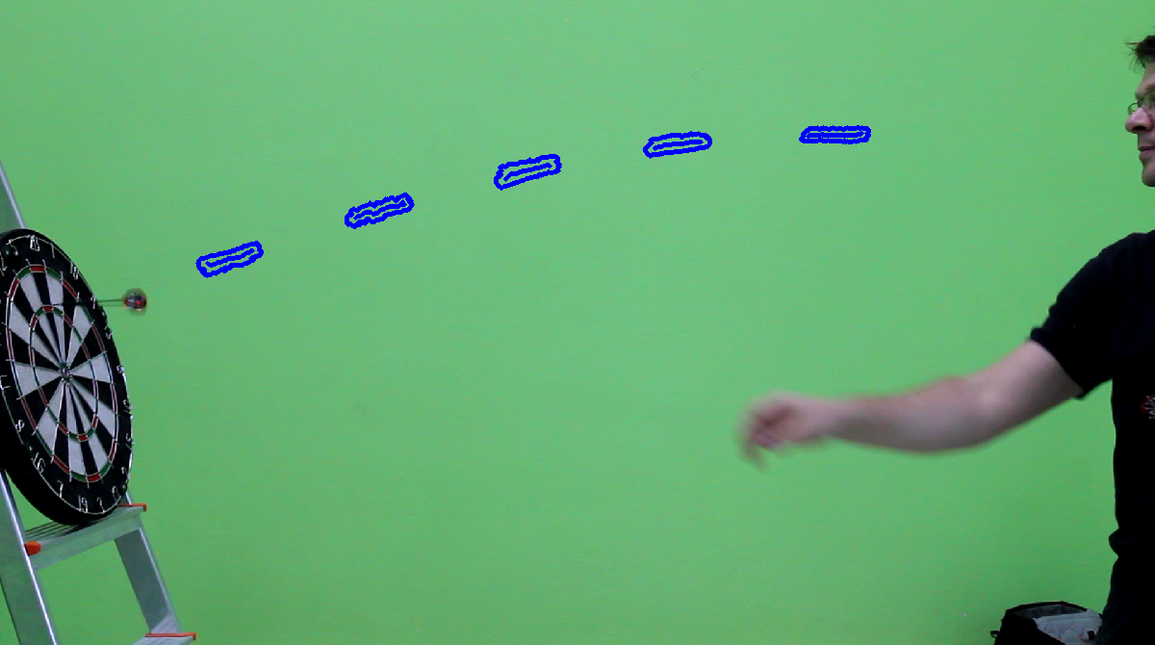
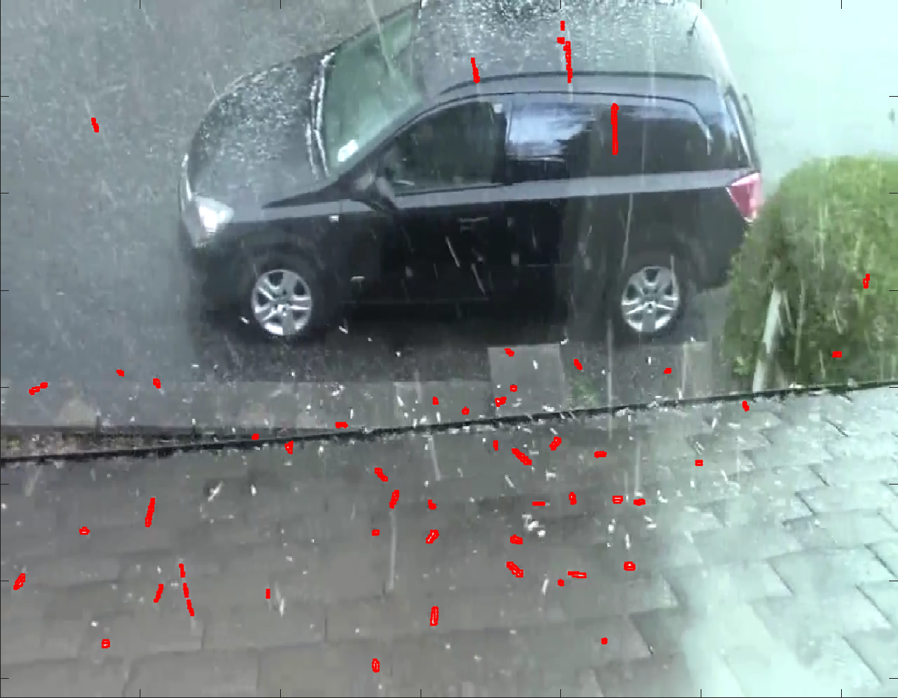
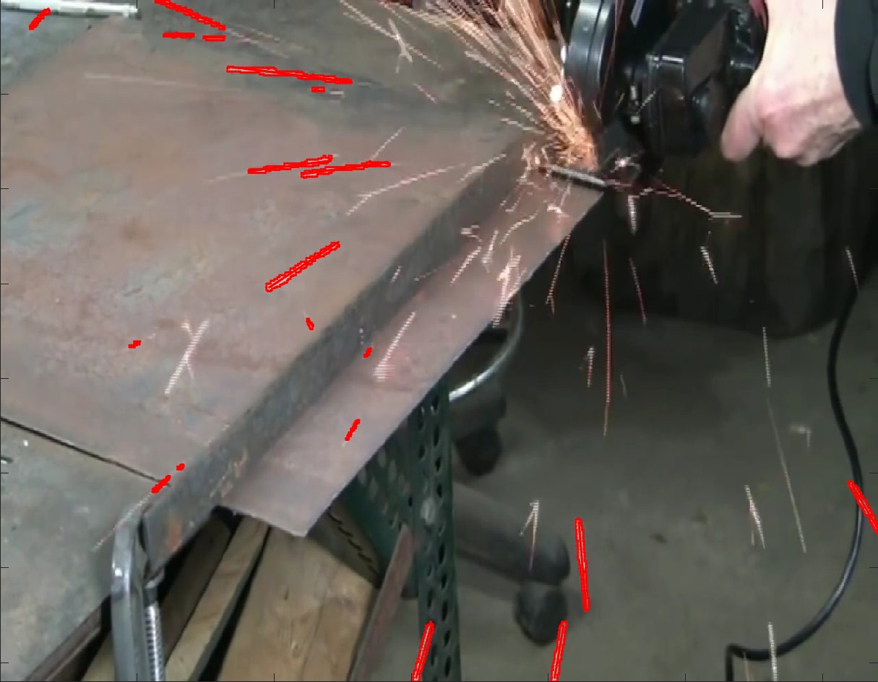

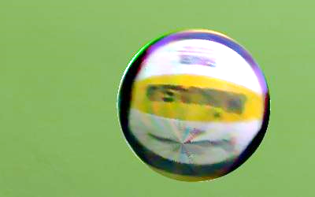

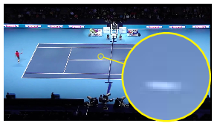
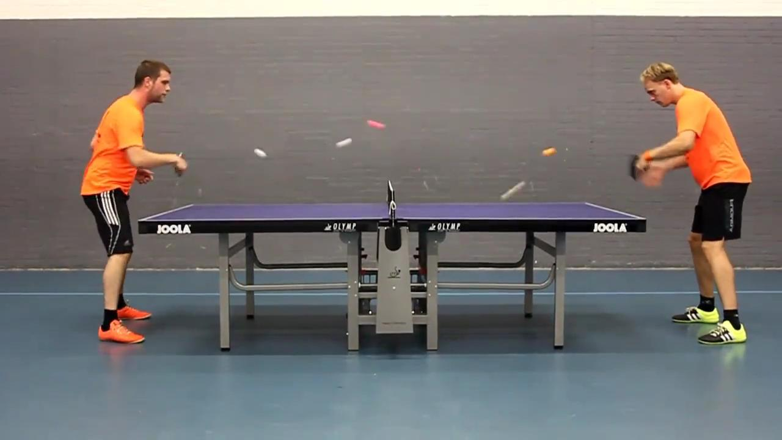
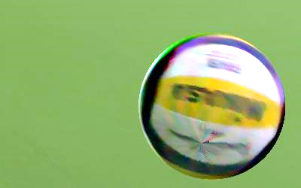

The World of Fast Moving Objects Denys Rozumnyi^{1,3} Jan Kotera² Filip Šroubek² Lukáš Novotný¹ Jiří Matas¹
¹CMP, Czech Technical University in Prague ²UTIA, Czech Academy of Sciences ³SGN, Tampere University of Technology
Introduction
FMO Localization Algorithms
Appearance Reconstruction
Definition (Fast Moving Object, FMO): object is fast moving if its trajectory projected on the image plane is larger than its size
Note: FMO is a property of the relative motion of object w.r.t. the camera
Detection algorithm*
Full FMO localization: Detection, Re-detection and Tracking
Minimization with priors on FMO appearance (F) and path (P)
More complex than blind deconvolution:
mixing with background (B)
blur (P) larger than the size of the FMO (F)
F arbitrary (~1min)
P from tracker assumed correct
prior(F): standard total variation
F simplified (~1s)
estimation of F and improved P
prior(P): polyline
prior(F): circular symmetry (demo)
prior(F): single-color sphere (table tennis)
estimation of F (color, radius) and improved P
Beyond convolution
rotating FMO → grid search over rotation axis and speed
rolling shutter → complicated space-variant blur
1. Input images → background
(estimated by median)
Image formation model:
… convolution
2.
(threshold set adaptively)
3. Stroky connected components
4. Not a lateral motion
(checked by KLT tracker)
I – Image
Alpha matte
B – Background
P – Path
F – FMO
Difference image:
5. Not a shadow → FMOs
(check of gradient fields)
no motion
estimated F
input I
Multiple FMOs:
Goal:
given I, recover (and F )
Detector
Analysis of Standard Tracking Sets: VOT [1], OTB [2], ALOV [3]
Re-detector
P by tracker
→ No FMOs present
→ Different tracking “worlds”
P by optimization
[1] Kristan et al. “The visual object tracking
VOT 2015 challenge results”, ICCV 2015
[2] Wu et al. “Online object tracking: A benchmark”,
CVPR 2013
[3] Smeulders et al. “Visual tracking:
An experimental survey”, PAMI 2014
[4] http://cmp.felk.cvut.cz/fmo/
Tracker
Detector
Re-detector
Tracker
motion
Intersection over Union (IoU)
Distance (px)
detections
Applications
FMO Annotated Public Dataset [4] and Examples
Examples
Temporal super-resolution 25 fps vs 250 fps
Angular velocity
Object counting
Projected translational velocity vs radar
Assumptions on one FMO:
single CC
multiple CCs
arbitrary contrast
OC
* has been improved since the submission (Bc. thesis Denys Rozumnyi)
Evaluation
OC
Criteria: precision, recall, F-score
SOTA trackers perform poorly
Example detections:
F-score (in %) of the proposed method and SOTA
1/250s
3/250s
OC
Example input frame
5/250s
OC
OC
1/25s
7/250s
9/250s
in a sequence
in a single frame
Estimated rotation axis
Appearance
reconstruction
High-speed
video

